Slide 1
Call, callCode, delegateCall

Slide 2
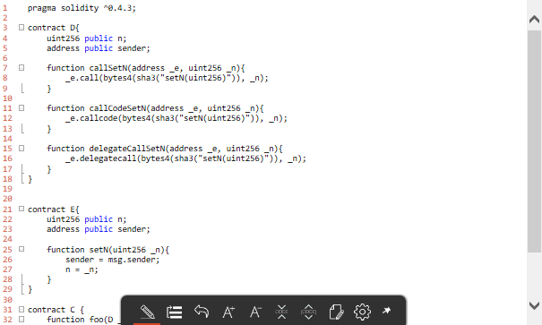

Slide 3
 | Initialized | call D->E | callCode D->E | callDelegate C->D->E
E (n) | Empty | N1 | N1 | N3
E (sender) | Empty | D address | D address | D address
D (n) | Empty | Empty | N2 | N2
D (sender) | Empty | Empty | D address | D address
C (n) | Empty | Empty | Empty | Empty
C (sender) | Empty | Empty | Empty | Empty
D address = 0x81c99a225e361e84718441dd1686af9df2e33cae
E address = 0x91c08e85fbb1095381ca506cbcb5667f33557a70
C address = 0x0b3c35a5f3c7a3d8e26187fc04585e17c264e89f

Slide 4
Libraries

Slide 5
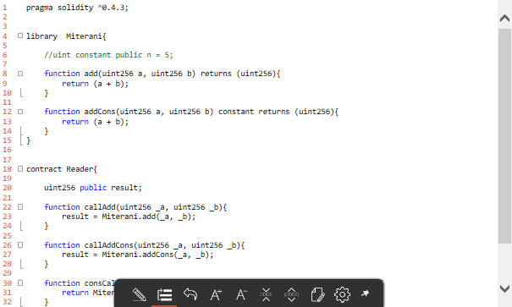

Slide 6
Reader calls | addCall | callAddCons | consCallAddCons
Result variable | Changed | changed | Unchanged
Transmission | Tx transmitted to the blockchain | Tx transmitted to the blockchain | No transaction is transmitted
Storage | Store variable at “Reader” contract | Store variable at “Reader” contract | Nothing is stored
Work | Calculation of (a+b) is required by the network | Calculation of (a+b) isn’t required by the network | All the work is done locally by the node

